Slide 1

Cardio GO
ECG in your Pocket

Slide 2
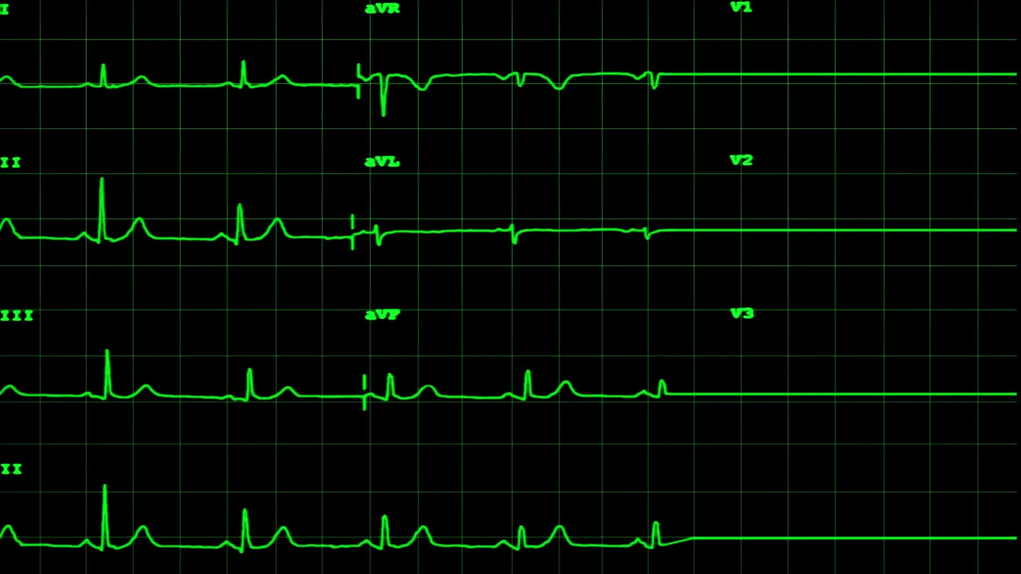
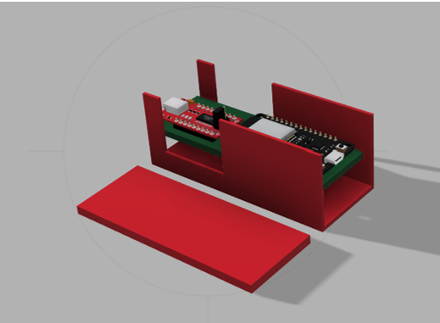
Team ID : CL64 Team Name : Abyss Minds
The Portable Solution for Heart Monitoring
Cardi GO The Pocket ECG
Problem ID : CL40
Problem Statement :
Student Innovation (Cutting-edge technology in these sectors continues to be in demand. Recent shifts in healthcare trends, growing populations also present an array of opportunities for innovation.)
Team Leader : Dipesh kr. Gyawali
Reg. No. : 12116492
Team Member 1 : Nitish kumar
Reg. No. : 12106559
Team Member 2 : Sasin Choudhary
Reg. No. : 12000098

Slide 3
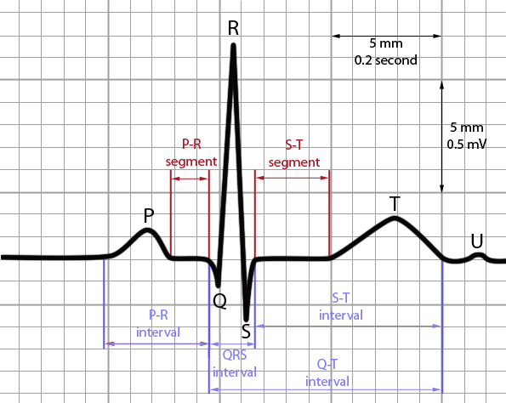
The Portable Solution for Heart Monitoring
Cardi GO a compact and affordable device revolutionizing ECG education.
Designed to provide real-time demonstrations of ECG signals and waveforms, this innovative tool empowers small organizations to teach the fundamentals of electrocardiography without the burden of costly equipment. With its user-friendly interface and portability, the Pocket ECG makes practical learning accessible anytime, anywhere as it Uploads the ECG Data to the Cloud.

Slide 4
Problem Statement
Institutions worldwide face a significant challenge in providing comprehensive healthcare education due to the exorbitant costs associated with acquiring medical equipment, such as Electrocardiogram (ECG) machines. The lack of access to these crucial tools limits the practical learning opportunities available to students and nurses in schools and colleges. As a result, a vast majority of educational institutions are unable to offer hands-on training in vital medical procedures, hampering the development of competent healthcare professionals and leaving students ill-prepared for real-world clinical settings. This discrepancy underscores a pressing need to address the affordability and accessibility of medical equipment to ensure that healthcare education remains inclusive and effective for future practitioners.
ECG Machine Model | Manufacturer | Cost (USD)
GE mac 2000 | GE healthcare | 2,18,000 INR
Phillips TC20 | Phillips Healthcare | 2,93,000 INR
Dr. Cardio Portable | Kavitul Technologies | 28,000 INR
Contec Channel ECG | Respbuy | 23,640 INR
Spandan 2.0 | Spandan | 16,000 INR

Slide 5

Our approach to the solution
To address the challenge of limited access to practical healthcare education due to the high cost of ECG machines, we have developed Cardio Go - a revolutionary ECG prototype. This innovative device utilizes an ESP32 microcontroller and an AD8232 sensor to capture biopotentials from the chest, generating accurate ECG graphs that display vital parameters such as the QRS complex and ST waves.
Key Features of Cardio Go:
Portable: Cardio Go is designed in a compact form factor, allowing users to carry it conveniently in their pockets, enabling on-the-go ECG monitoring and analysis.
Cost-Effective: By leveraging affordable components and innovative technology, Cardio Go offers a significantly lower cost compared to traditional ECG machines, making it accessible to educational institutions, healthcare facilities, and individuals alike.
Cloud Connectivity: Cardio Go seamlessly uploads ECG data to the cloud, enabling remote access from anywhere in the world. Users can securely access and analyze ECG readings using their credentials, facilitating collaboration and consultation among healthcare professionals and educators.
Comprehensive Data Analysis: The Cardio Go platform provides detailed insights into cardiac health by analyzing ECG signals and identifying abnormalities, empowering users to make informed decisions about patient care and educational curriculum development.
By introducing Cardio Go, we aim to democratize access to practical healthcare education and ECG monitoring, ensuring that students, nurses, and healthcare professionals have the tools they need to succeed. With its portable design, affordability, and cloud connectivity, Cardio Go revolutionizes the way we measure and analyze ECG data, putting cardiac health assessment in the hands of everyone, everywhere.

Slide 6
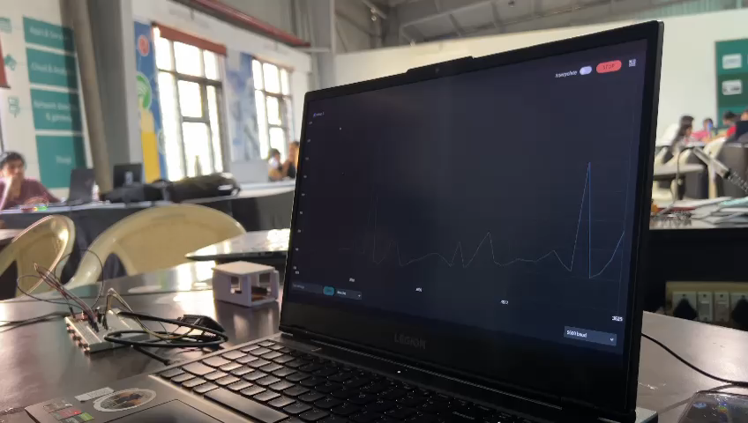

Slide 7
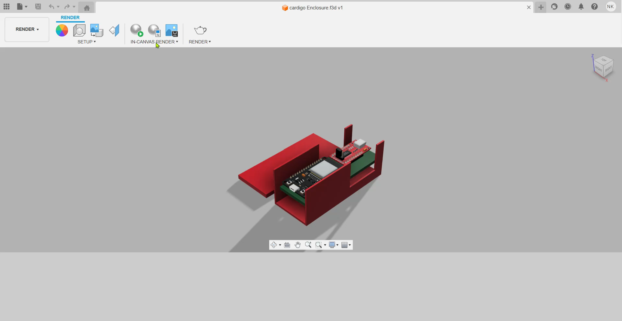
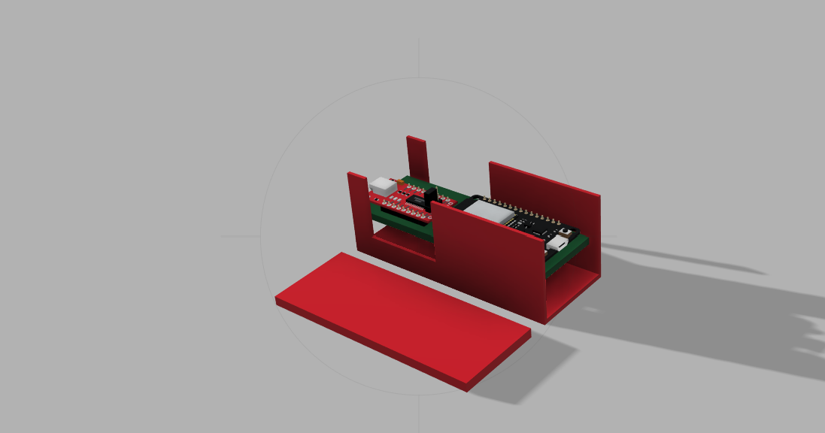
3D Autocad Model

Slide 8
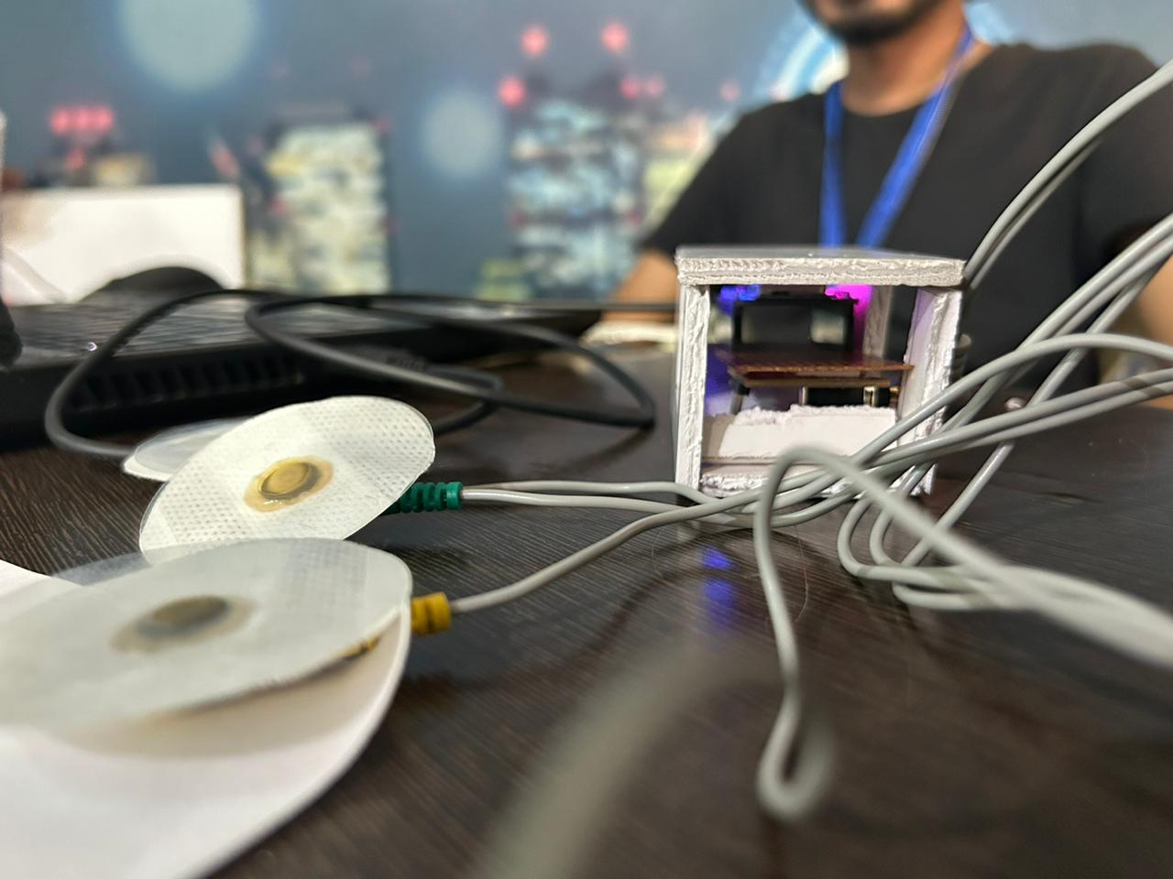
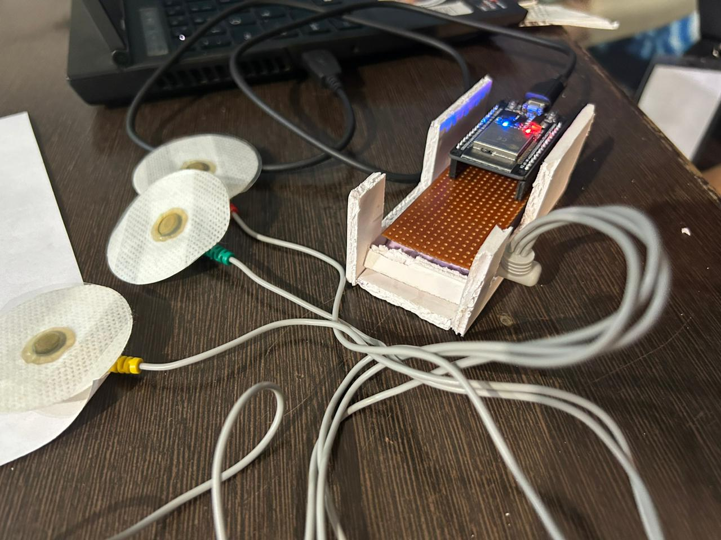
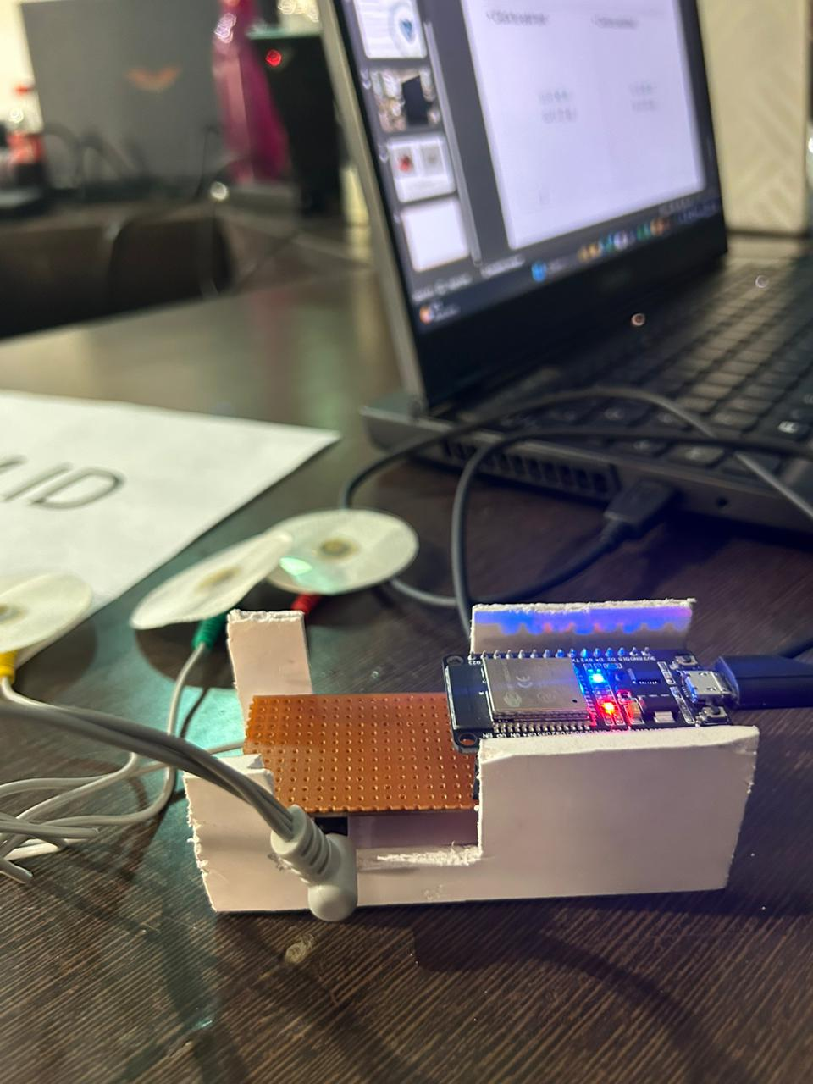
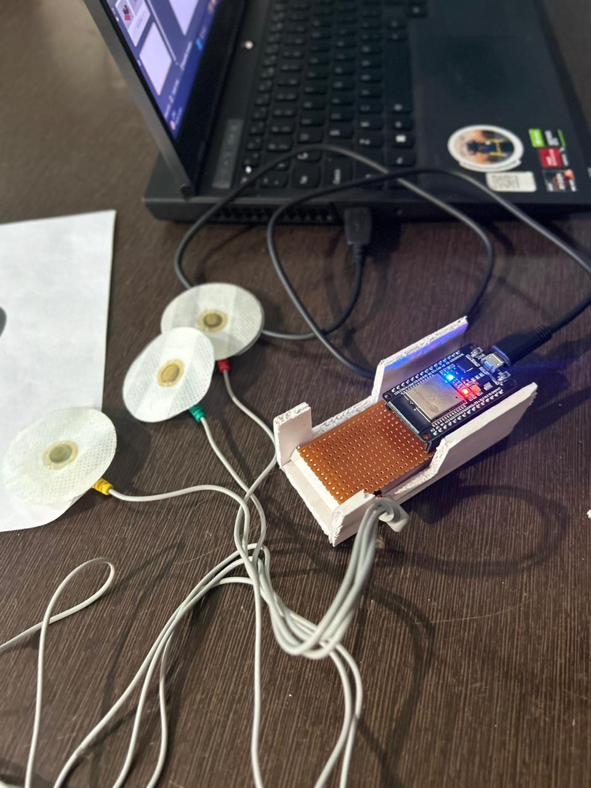
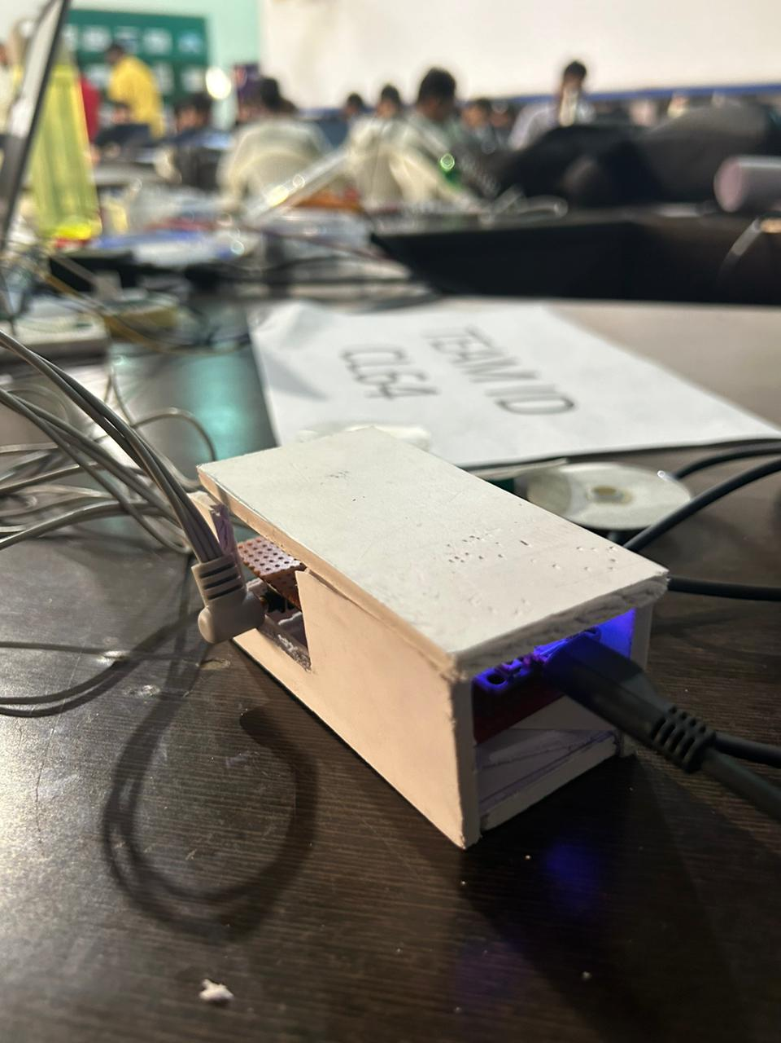
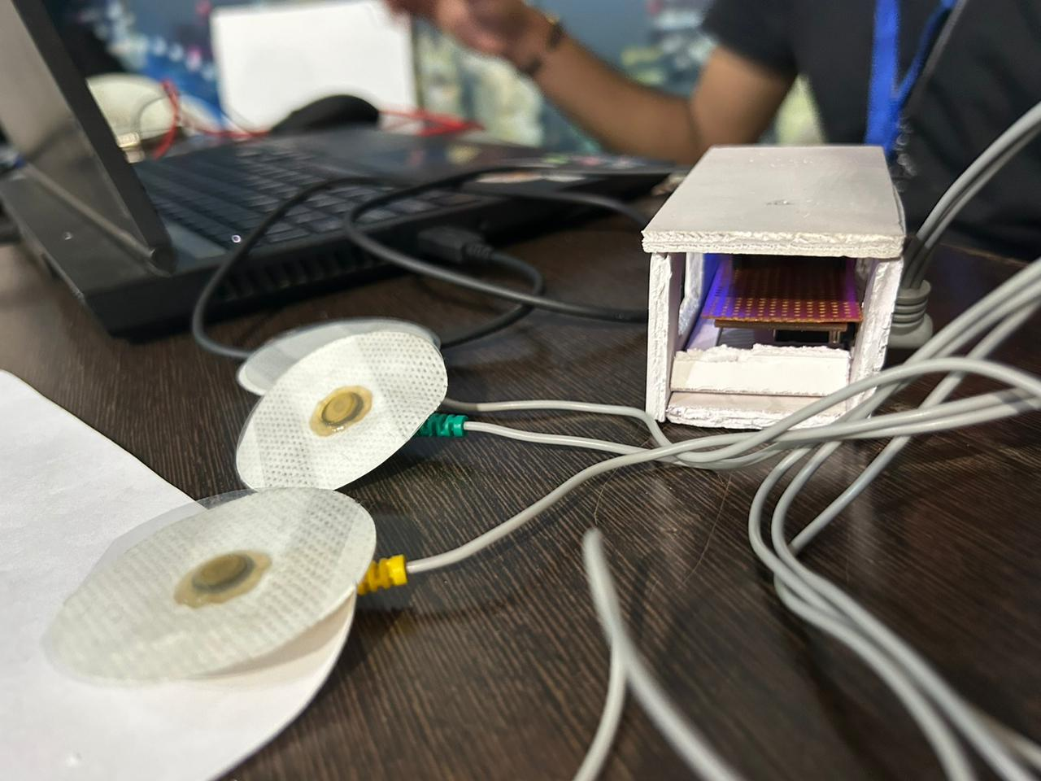
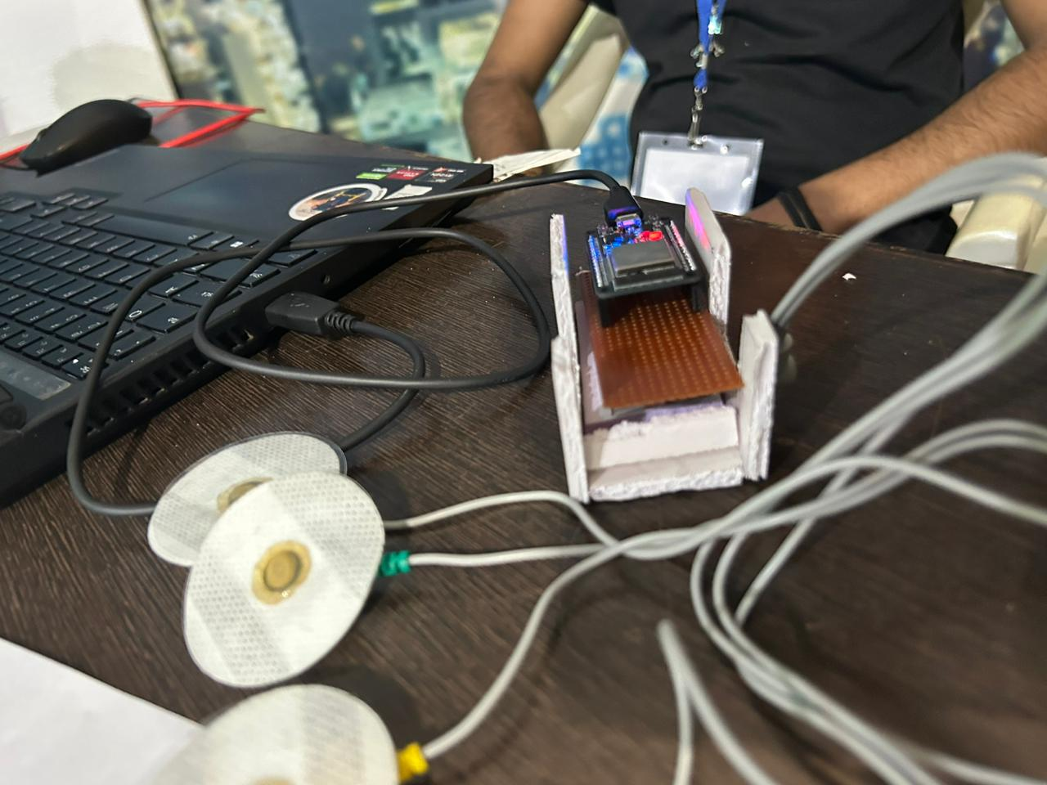
Final prototype pictures
Total cost of prototype is 2000 INR only

